Slide 1

INNOBI BUSINESS INTELLIGENCE SERVICES
Business Intelligence Services, April 2020, © INNOBI Software

Slide 2

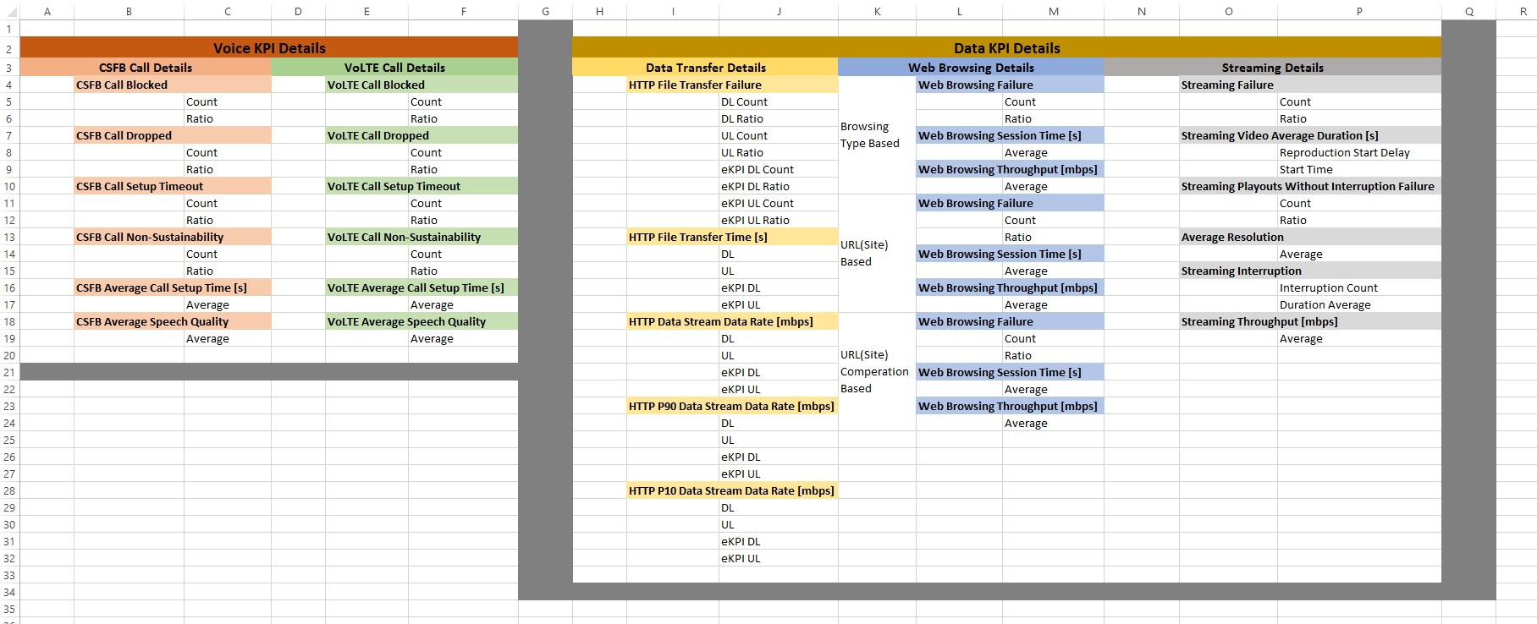
Contents of Dashboard
2
Business Intelligence Services, April 2020, © INNOBI Software

Slide 3
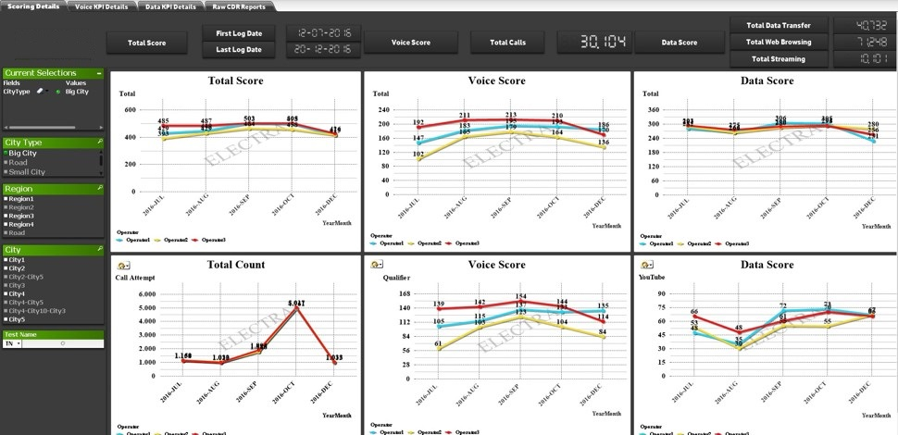
Qlikview Scoring Details , Big City Selected
3
Business Intelligence Services, April 2020, © INNOBI Software

Slide 4
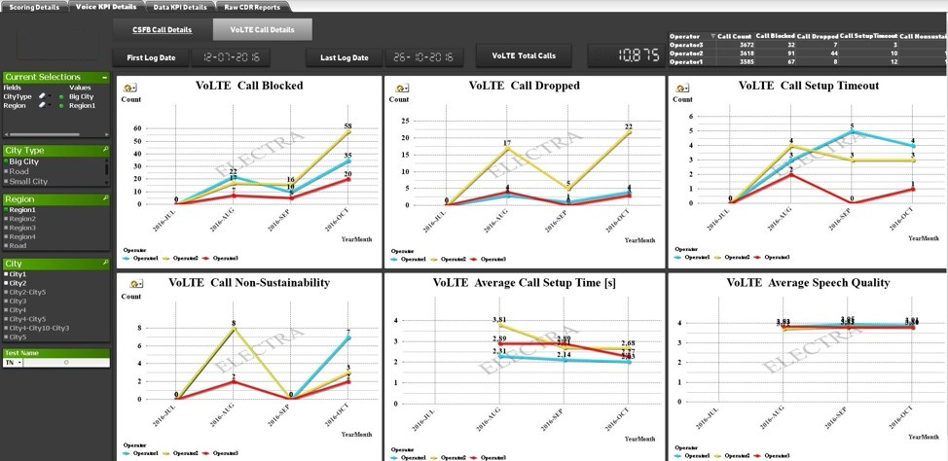
Qlikview Voice => Volte Call KPI Details , Big City & Region1 Selected
4
Business Intelligence Services, April 2020, © INNOBI Software

Slide 5
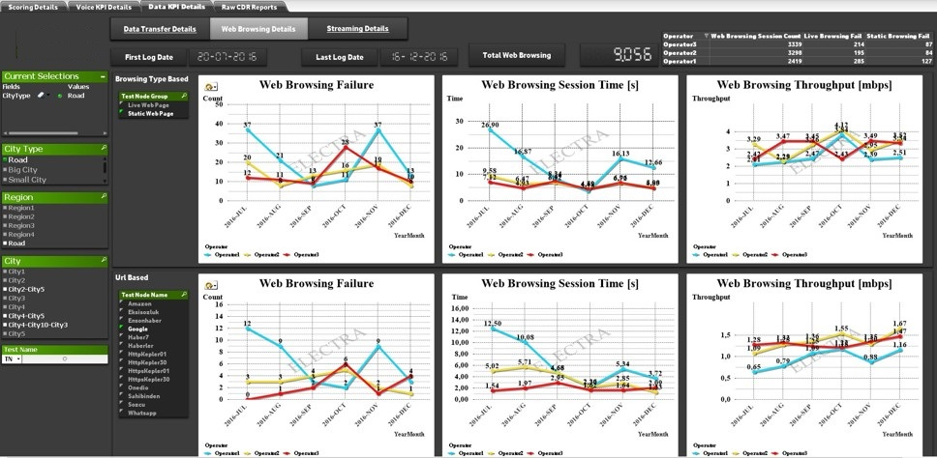
Qlikview Raw CDR Report & Export, Small City & City3 Selected
5
Business Intelligence Services, April 2020, © INNOBI Software

Slide 6
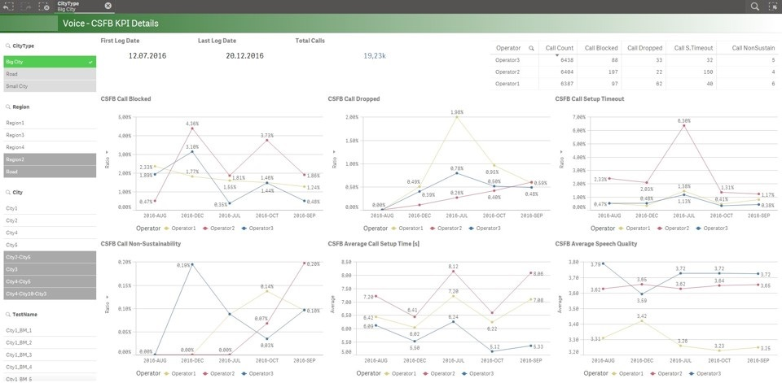
QlikSense Voice => CSFB Call KPI Details , Big City Selected
6
Business Intelligence Services, April 2020, © INNOBI Software

Slide 7
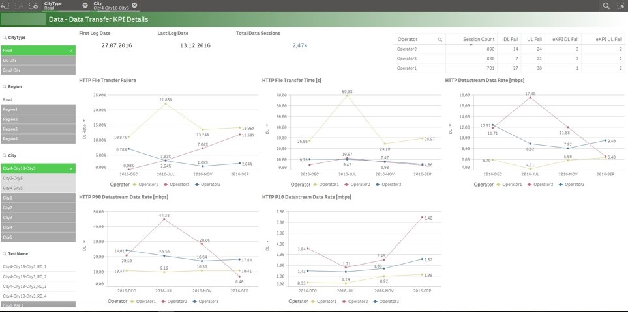
QlikSense Data => File Transfer KPI Details , Road Selected
7
Business Intelligence Services, April 2020, © INNOBI Software

Slide 8
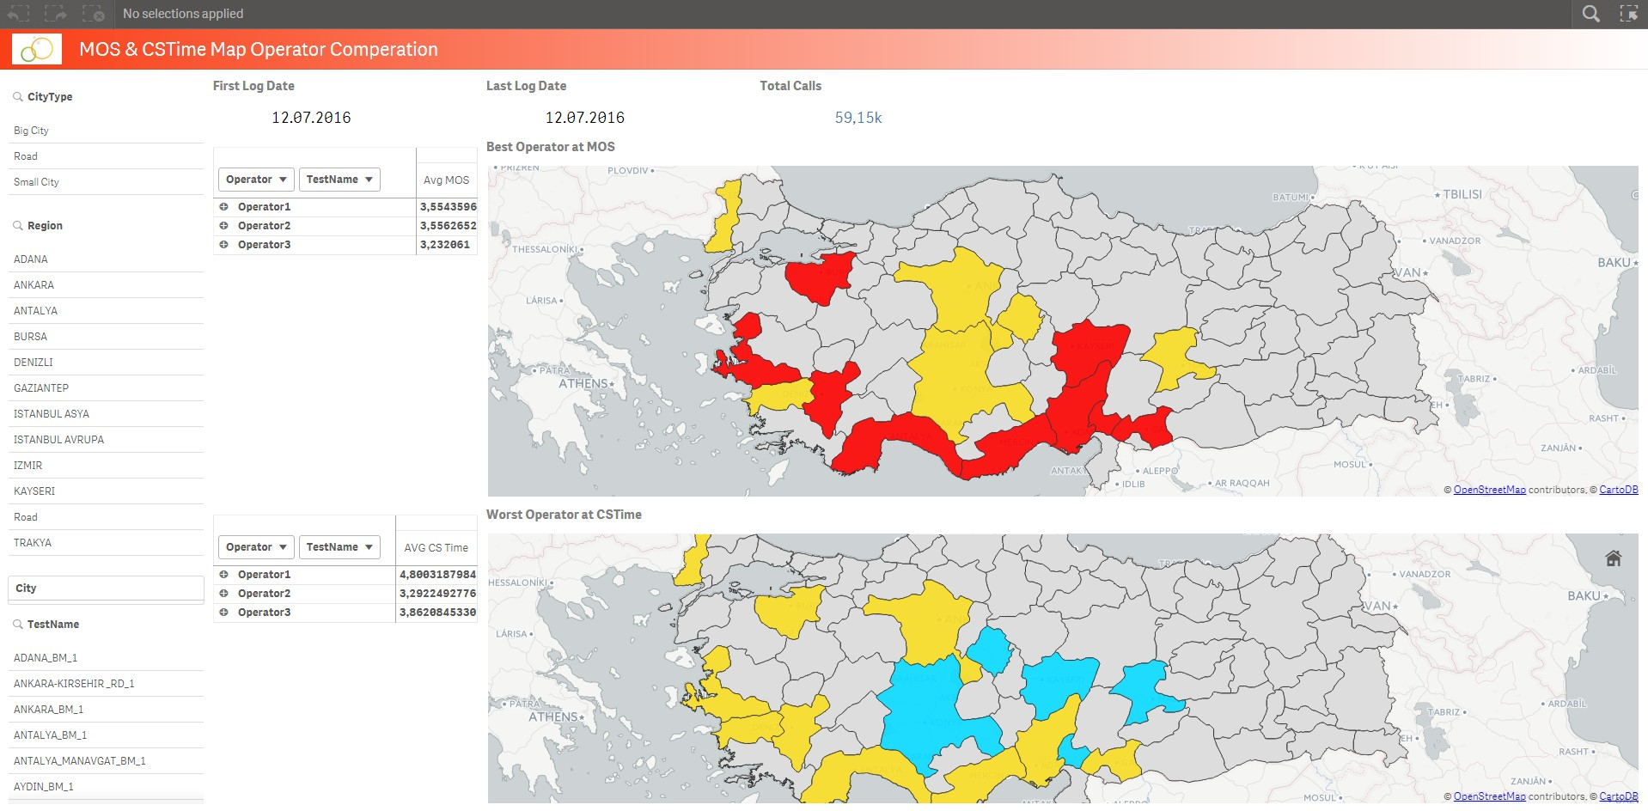
QlikSense MOS & Call Setup Time
8
Business Intelligence Services, April 2020, © INNOBI Software

Slide 9
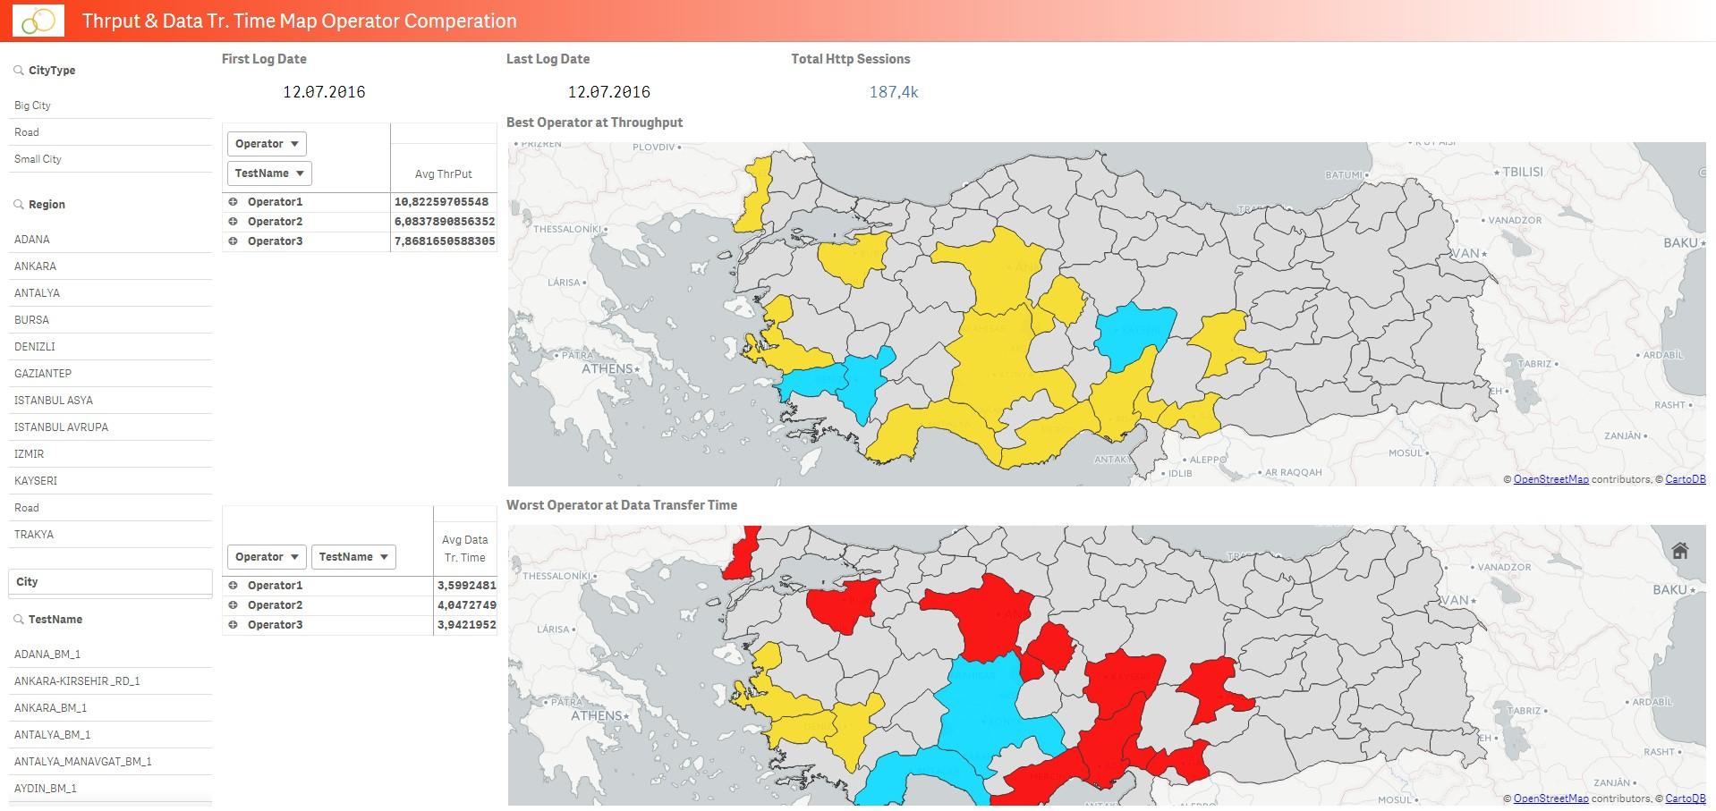
QlikSense Throughput & File Transfer Time
9
Business Intelligence Services, April 2020, © INNOBI Software

Slide 10
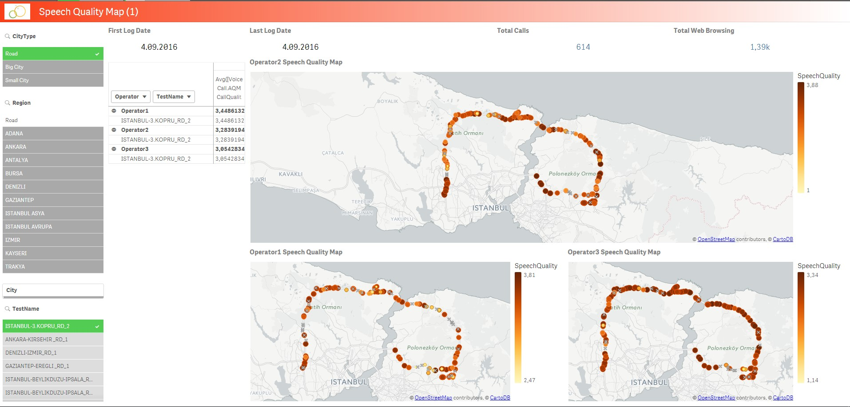
QlikSense Speech Quality 3 Operators
10
Business Intelligence Services, April 2020, © INNOBI Software

